Slide 1
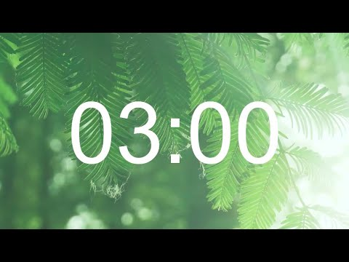
Warm up - Bob Brothers
Warm up: 3/15/23
Write or draw:
When would it be hard to forgive yourself?

Slide 2
Main character: “What am I going to do… everyone's laughing at me…”
Inner critic: “Of course they are laughing at you! You tried to give an answer and it was wrong! You are a fool!”
Main character: “Oh gosh, I am never sharing an answer again!”
Inner coach: “Wait wait wait! Your ideas are awesome! So you messed up this time, so what! Try again and share your idea about pizza! Everyone will love it!
Main character: “Oh you are right! Then they will see my true genius! Here I go!”

Slide 3
How can we diversely add inner thoughts into a play?
Monologue with “self”, “inner coach” and “inner critic”
Two different scenes (comic)
Play “freezes” to hear inner thoughts
Main character can say thoughts in different tone
Different versions appear on shoulders!

Slide 4
Diverse ways to present your scene:
Make a book with pictures
Make a puppet show
Make a reader theater
Make a play (memorize)
Improv - make it up as you go!

Slide 5
Pick your inner?
Don’t try so hard, it’s not cool.
You’re not good enough to_________.
You really messed up. You can’t do anything right.
Another mistake. You are really stupid.
Nobody likes you.
Don’t wear that or they’ll make fun of you...
People won’t like you if you ________.
You can’t do it, so don’t even bother trying.
You are the worst friend. Why would anyone want to be friends with you?
How to present: Puppet? Book? Play?
How do inner thoughts fit?

Slide 6
Seating Chart - Bobs
Jayden | David | Avniel |  | Keira | Issac | Carlos | Yosiah
RJ | Joaquin | Brielle
Serenity | Aiden |  |  | Monique | Sharae | Kevin

Slide 7
Seating Chart - Depps
Natalia | Dylan | Andre |  | Jasiah | Adan | Endo | Aubree
Jessica | Rico | Angel
Jayleen | Monica |  |  | Azaria | Sophia | Esme | Carlos

Slide 8
Coding goals:
Use your knowledge of “comments” and fraction visuals to create videos that show solutions to fraction division problems

Slide 9
Coding goals:
This is part of your final art integrated assessment for fraction division!
Be diverse and focused!

Slide 10
Coding goals:
Let’s get to know the coding first!

Slide 11
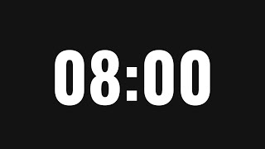
Making and Downloading Videos with Fraction Objects
Change the fractions and comments
Change the speed

Slide 12
Creating a video for multiplication
Change the multiplication problem
Change the comments
Change the speed

Slide 13
Video part 2
Change the multiplication problem
Change the comments
Change the speed

Slide 14
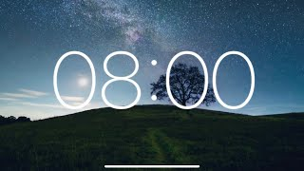
Warm ups
Work independently on your warms ups
Think about how you can use the coding you just learned to show your solutions!

Slide 15
Use the coding!
Check with your team that you agree on the correct diagrams and solutions
Check your answers on the computer using coding
Create videos to show your answers. Download them if finished!

Slide 16
Shout outs!

Slide 17
Main lesson
Work independently on your assigned problem
Work on a different problem if you have extra time.
Think about how you can use the coding you just learned to show your solutions!

Slide 18
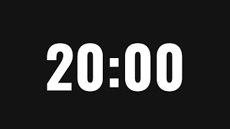
Use the coding!
Check with your team that you agree on the correct diagram and solution
Check your answers on the computer using coding
Create videos to show your answers.
Download them if finished!
Diversity, Details, Organization
Add pictures or comments to explain

Slide 19
Shout outs!

